Slide 1

KEYLOGGER AND SECURITY
FINAL PROJECT
SAISANKAR BALLEDA

Slide 2

KEYLOGGER
A keylogger is a programme or tool designed to monitor and keep a tab on the A keylogger is a A keylogger is a programmrogramA keyloA keylogger is a programme or tool designed to monitor and keep a tab on the “keystrokes” er keyboard.
This enables ohasjhwdskfcnwkdncknc, s.c,mwdfdmvwdfijn compromising ords etc..
programme or tool designed to monitor and keep a tab on the “keystrokes” made on the user keyboard.
This enables on compromising sensitive data like passwords etc..
“keystrokes” made on the user keyboard.
A keylogger is a programme or tool designed to monitor and keep a tab on the “keystrokes” made on the user keyboard.
This enables on compromising sensitive data like passwords etc..

Slide 3
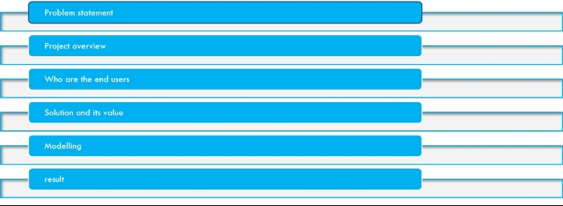
AGENDA

Slide 4
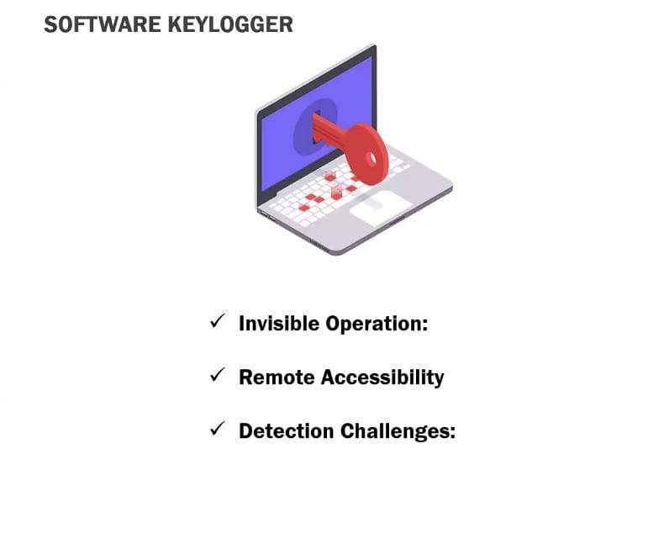
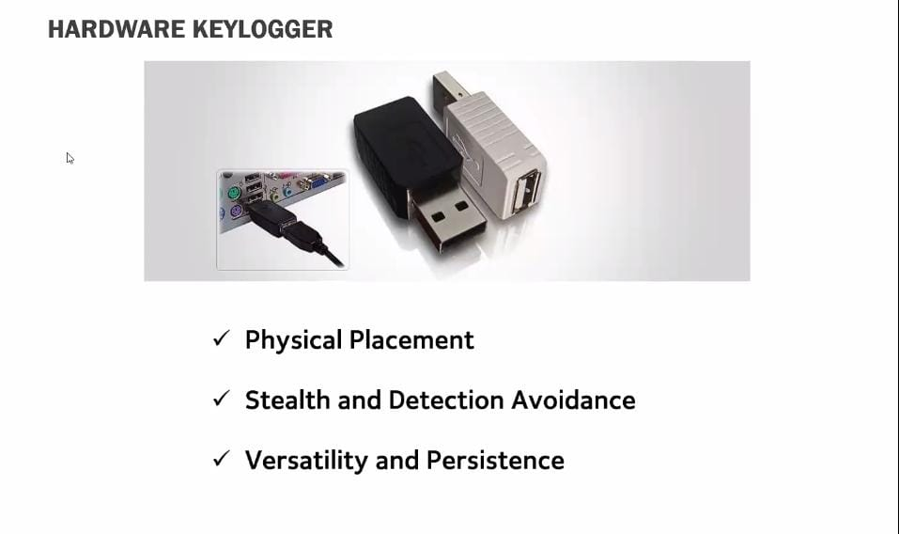
PROp p PROBLEM STATEMENTTEMENT PROBLEM STATEMENTPROBLEM STATEMENTererfBLEM STATEMENT
●The problem statement is that the keyloggers can be detected using antiviruses.
●Installation of hardware keyloggers is difficult without the knowledge of the owner of the system.
●The solution to the above existing problem is that we can build a software keyloggers instead of hardware keyloggers

Slide 5
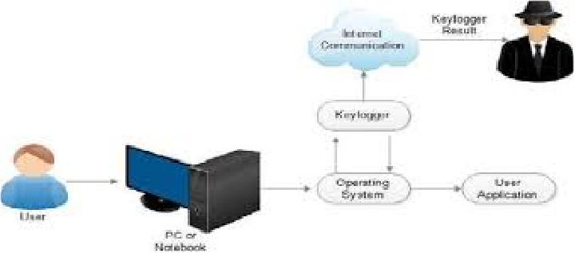
project overview
PROJECT OVERVIEW
●Keylogging is the action of capturing and recording keys struck on a keyboard.
●A keylogger is a program which captures and monitors all keylogs.
●Keyloggers can be both in the form of a built software program or directly downloaded onto a hardware module.

Slide 6
WHO ARE THE END USERS?
●Keyloggers are used in IT organizations to troubleshoot technical problems with computers and business networks.
●Families and businesspeople use keyloggers legally to monitor network usage without their users' direct knowledge.
●Microsoft publicly stated that window 10 has a built-in keylogger in its final version "to improve typing and writing services“.

Slide 7
benfits of keyloger in cs
Insider threats: The keystroke recorder secures confidential data from insider threats if any, along with tracking keyboard usage.
RECORDED REPORTS: Keyloggers are terrific assistance in registering the reports of the completed projects in their cloud storage for project managers to access it anytime to inspect the employees’ productivity.
PRODUCTIVITY TRACKER: One of the best advantages of keyloggers is tracking employee productivity(especially in the remote work structure). A keystroke recorder can support maintaining the work balance for the management teams by distinguishing between the productive and non-productive workforce.

Slide 8
Modeling
Insider threats: The keystroke recorder secures confidential data from insider threats if any, along with tracking keyboard usage.
RECORDED REPORTS: Keyloggers are terrific assistance in registering the reports of the completed projects in their cloud storage for project managers to access it anytime to inspect the employees’ productivity.
PRODUCTIVITY TRACKER: One of the best advantages of keyloggers is tracking employee productivity(especially in the remote work structure). A keystroke recorder can support maintaining the work balance for the management teams by distinguishing between the productive and non-productive workforce.

Slide 9
Modeling
Insider threats: The keystroke recorder secures confidential data from insider threats if any, along with tracking keyboard usage.
RECORDED REPORTS: Keyloggers are terrific assistance in registering the reports of the completed projects in their cloud storage for project managers to access it anytime to inspect the employees’ productivity.
PRODUCTIVITY TRACKER: One of the best advantages of keyloggers is tracking employee productivity(especially in the remote work structure). A keystroke recorder can support maintaining the work balance for the management teams by distinguishing between the productive and non-productive workforce.

Slide 10
Result
Insider threats: The keystroke recorder secures confidential data from insider threats if any, along with tracking keyboard usage.
RECORDED REPORTS: Keyloggers are terrific assistance in registering the reports of the completed projects in their cloud storage for project managers to access it anytime to inspect the employees’ productivity.
PRODUCTIVITY TRACKER: One of the best advantages of keyloggers is tracking employee productivity(especially in the remote work structure).
A keystroke recorder can support maintaining the work balance for the management teams by distinguishing between the productive and non-productive workforce.
work structure). A keystroke recorder can support maintaining the work balance for the management teams by distinguishing between the productive and non-productive workforce.

Slide 11
Project links
project link:https://github.com/Saisankar62/saisankara-project.git

